Slide 1
OSTEOPOROSIS PREDICTION

Slide 2
GOAL
To build a predictive model for determining Osteoporosis using provided data, emphasizing preprocessing steps like discarding irrelevant columns and potentially using the same dataset for both training and testing.

Slide 3
ABOUT DATASET
It contains 880 Rows and 27columns.
Target Column is : Diagnosis(Normal / Osteopenia / Osteoporosis)

Slide 4
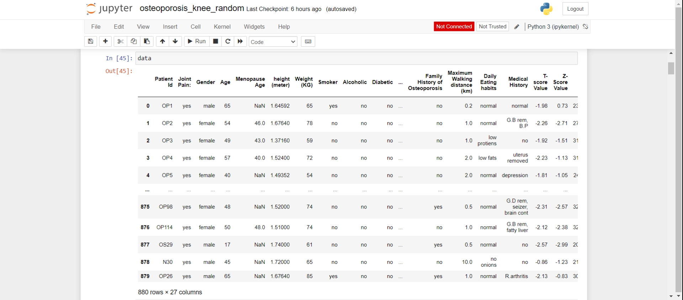
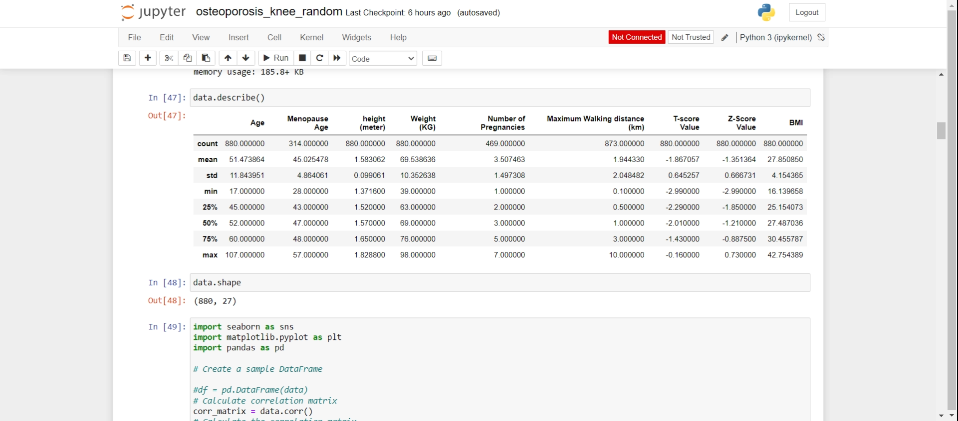
DATASET

Slide 5
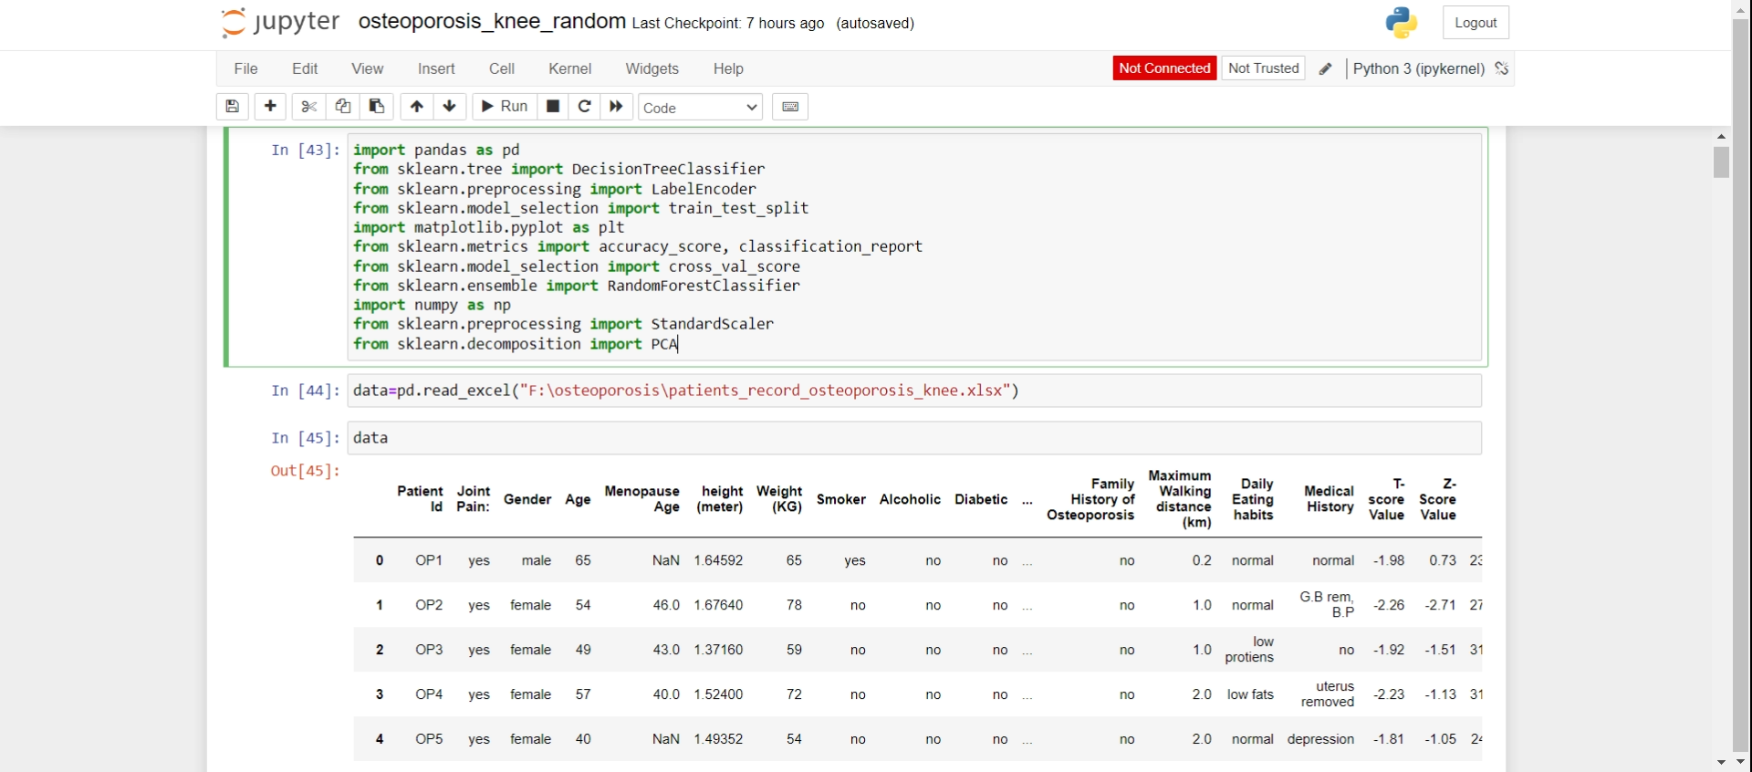
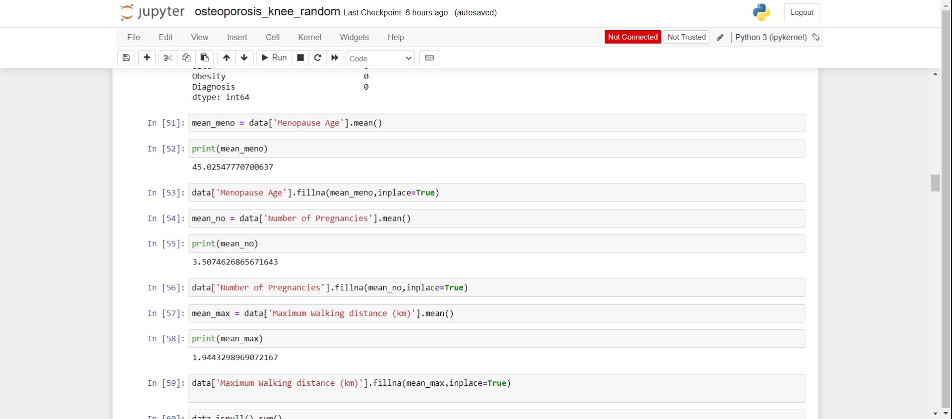
ETL PROCESS
Extract:
Data extraction involves retrieving raw data from the source. In your case, you've extracted the data from an Excel file using Pandas
Transform:
Data transformation involves cleaning and preparing the data for analysis.
Handling missing values: To address missing values, you've replaced null values with the mean of each column. This ensures that no data is lost and that the dataset remains representative. For example, you've replaced missing values in columns like 'Menopause Age', 'Number of Pregnancies', and 'Maximum Walking distance (km)' by computing the mean of each respective column and filling the null values with these calculated means.

Slide 6
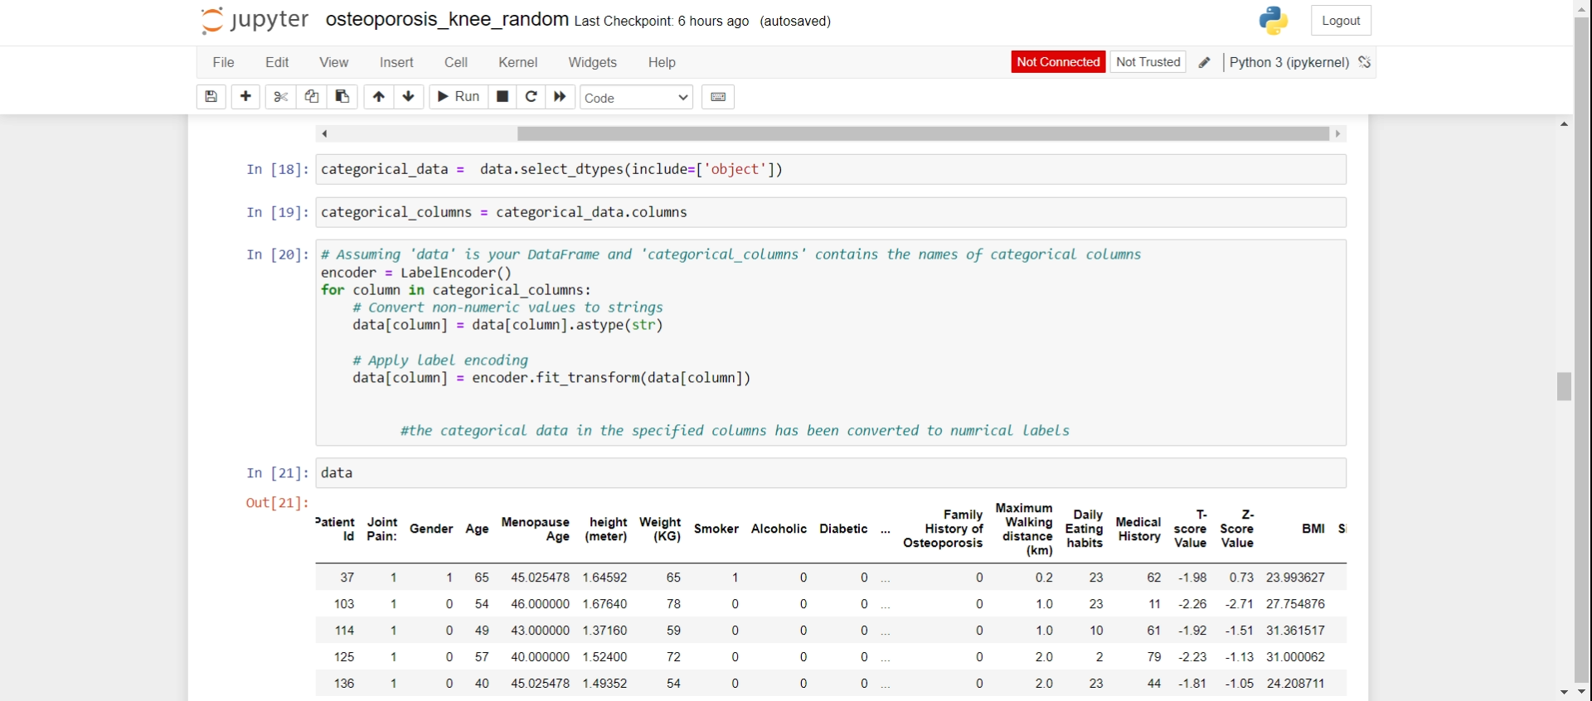
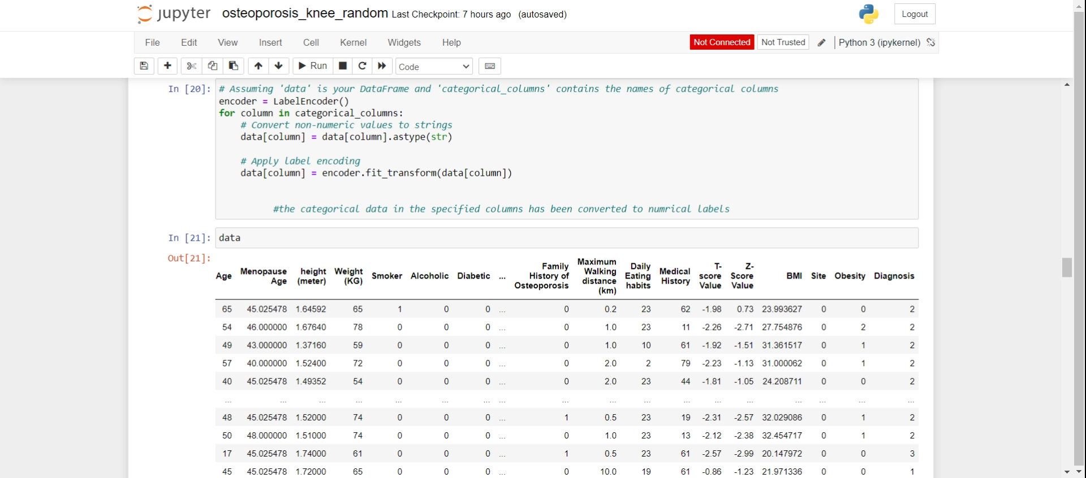
Encoding Categorical
You converted categorical variables into numerical labels using LabelEncoder, making it easier for machine learning algorithms to process them.

Slide 7
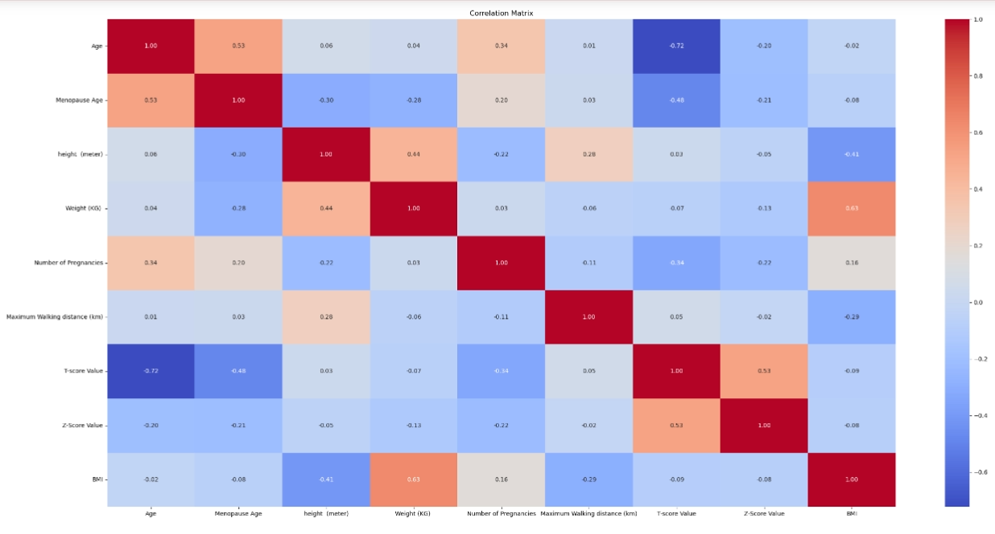
CORRELACTION MATRIX

Slide 8
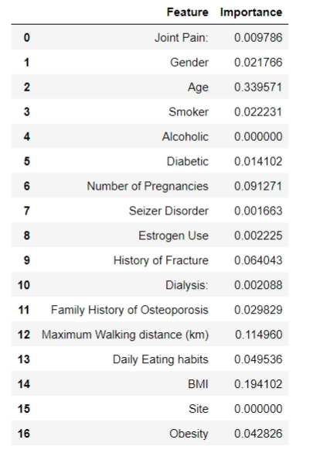
FEATURE SELECTION

Slide 9
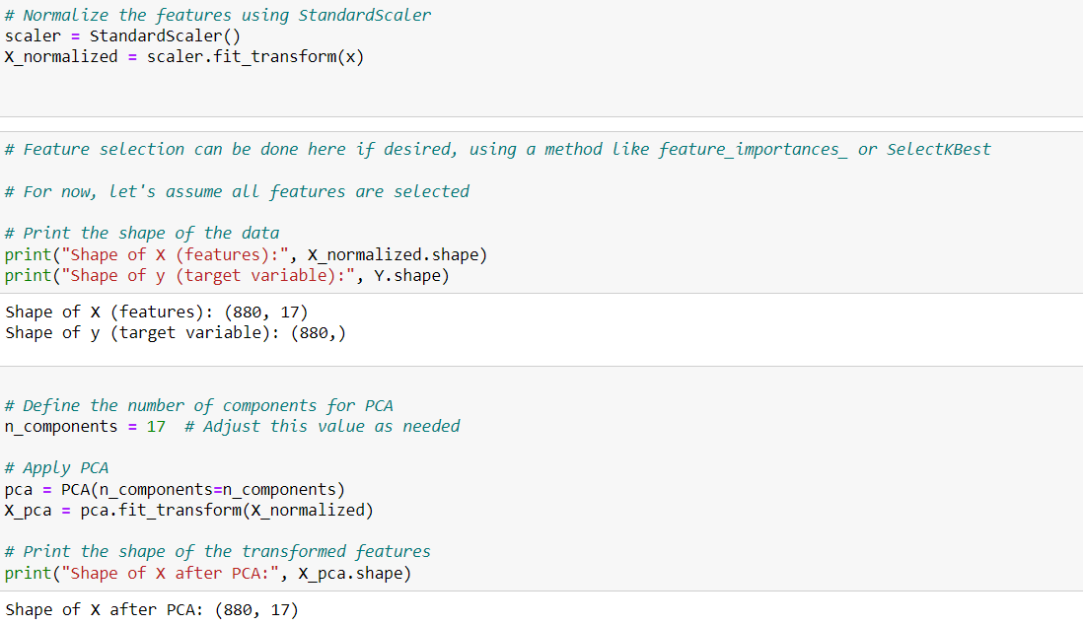
FEATURE EXTRATION
x (independent): joint Pain ,Gender, Age, Smoker
, Alcoholi , Diabetic ,Number of Pregnancies ,Seizer Disorder, Estrogen Use, History of Fracture, Dialysis, Family History of Osteoporosis, Maximum Walking distance, Daily Eating habits, BMI, Site ,Obesity
Y(dependent): Diagnosis
Outcome:- Osteoporosis

Slide 10
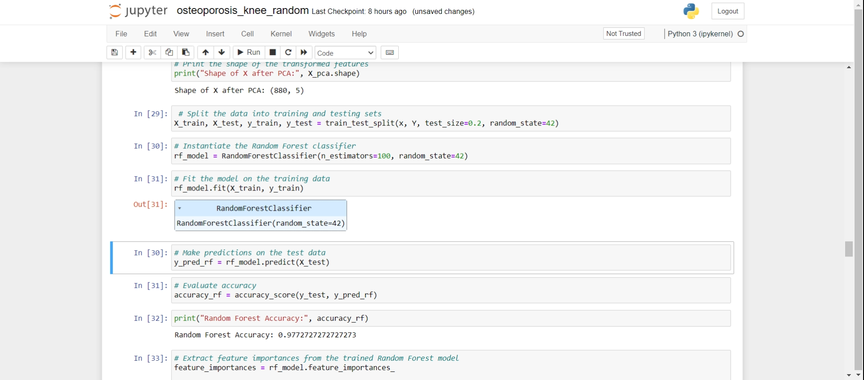
RANDOM FOREST
Random forest ,that combines the output of multiple decision trees to reach a single result. Its ease of use and flexibility have fueled its adoption, as it handles both classification and regression problems.
Model Train and Test

Slide 11
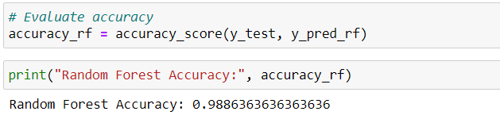
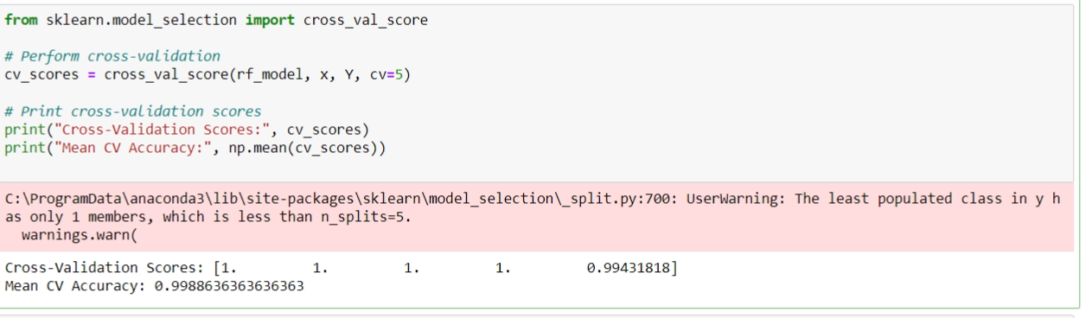
ACCURACY
CROSS VALIDATION

Slide 12
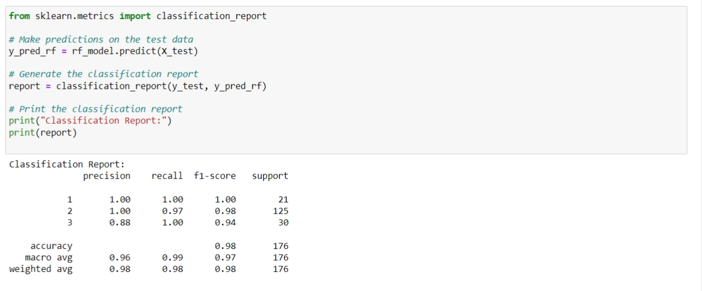
EVALUTION MATRIX

Slide 13
COMPARATIVE ANALYSIS

Slide 14
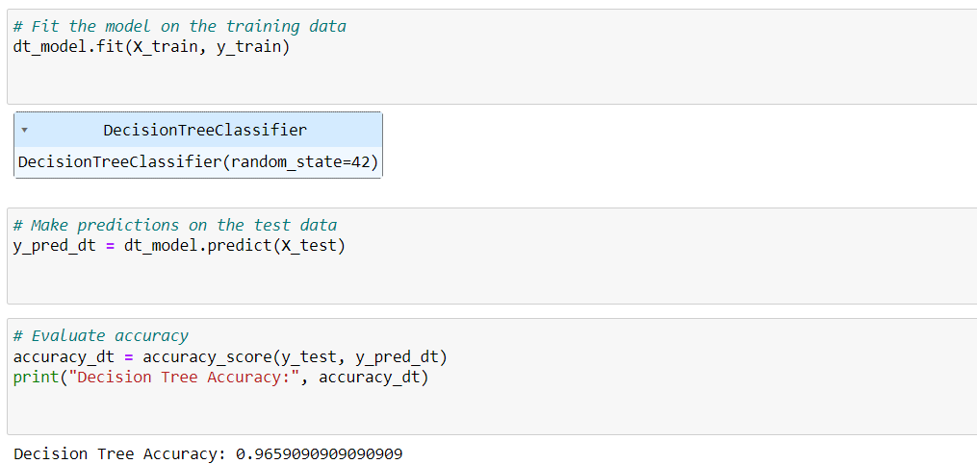
DECISION TREE

Slide 15
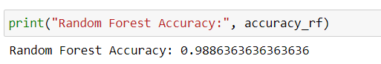
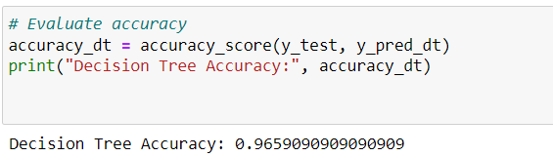
Random forest
accuracy
Decision tree
accuracy

Slide 16
THANK YOU!

